Slide 1
Machine Learning
Jesse Davis
jdavis@cs.washington.edu

Slide 2
Outline
Brief overview of learning
Inductive learning
Decision trees

Slide 3
A Few Quotes
“A breakthrough in machine learning would be worth
ten Microsofts” (Bill Gates, Chairman, Microsoft)
“Machine learning is the next Internet”
(Tony Tether, Director, DARPA)
Machine learning is the hot new thing”
(John Hennessy, President, Stanford)
“Web rankings today are mostly a matter of machine learning” (Prabhakar Raghavan, Dir. Research, Yahoo)
“Machine learning is going to result in a real revolution” (Greg Papadopoulos, CTO, Sun)

Slide 4
So What Is Machine Learning?
Automating automation
Getting computers to program themselves
Writing software is the bottleneck
Let the data do the work instead!

Slide 5
Traditional Programming
Machine Learning
Data
Computer
Output
Program
Data
Computer
Program
Output

Slide 6
Sample Applications
Web search
Computational biology
Finance
E-commerce
Space exploration
Robotics
Information extraction
Social networks
Debugging
[Your favorite area]

Slide 7
Defining A Learning Problem
A program learns from experience E with respect to task T and performance measure P, if it’s performance at task T, as measured by P, improves with experience E.
Example:
  Task: Play checkers
  Performance: % of games won
  Experience: Play games against itself

Slide 8
Types of Learning
Supervised (inductive) learning
  Training data includes desired outputs
Unsupervised learning
  Training data does not include desired outputs
Semi-supervised learning
  Training data includes a few desired outputs
Reinforcement learning
  Rewards from sequence of actions

Slide 9
Outline
Brief overview of learning
Inductive learning
Decision trees

Slide 10
Inductive Learning
Inductive learning or “Prediction”:
  Given examples of a function (X, F(X))
  Predict function F(X) for new examples X
Classification
  F(X) = Discrete
Regression
  F(X) = Continuous
Probability estimation
  F(X) = Probability(X):

Slide 11
Terminology
Feature Space:
Properties that describe the problem
0.0 1.0 2.0 3.0
0.0 1.0 2.0 3.0 4.0 5.0 6.0

Slide 12
Terminology
Example:
<0.5,2.8,+>
0.0 1.0 2.0 3.0
+
+
+
+
-
+
+
-
-
-
-
+
+
-
-
+
-
-
+
-
-
+
+
+
-
-
0.0 1.0 2.0 3.0 4.0 5.0 6.0

Slide 13
Terminology
Hypothesis:
Function for labeling examples
0.0 1.0 2.0 3.0
+
+
Label: +
+
Label: -
?
+
-
+
+
-
-
-
-
+
+
-
?
?
-
+
-
-
+
-
-
+
+
+
-
?
-
0.0 1.0 2.0 3.0 4.0 5.0 6.0

Slide 14
Terminology
Hypothesis Space:
Set of legal hypotheses
0.0 1.0 2.0 3.0
+
+
+
+
-
+
+
-
-
-
-
+
+
-
-
+
-
-
+
-
-
+
+
+
-
-
0.0 1.0 2.0 3.0 4.0 5.0 6.0

Slide 15
Supervised Learning
Given: <x, f(x)> for some unknown function f
Learn: A hypothesis H, that approximates f
Example Applications:
Disease diagnosis
x: Properties of patient (e.g., symptoms, lab test results)
f(x): Predict disease
Automated steering
x: Bitmap picture of road in front of car
f(x): Degrees to turn the steering wheel
Credit risk assessment
x: Customer credit history and proposed purchase
f(x): Approve purchase or not

Slide 16
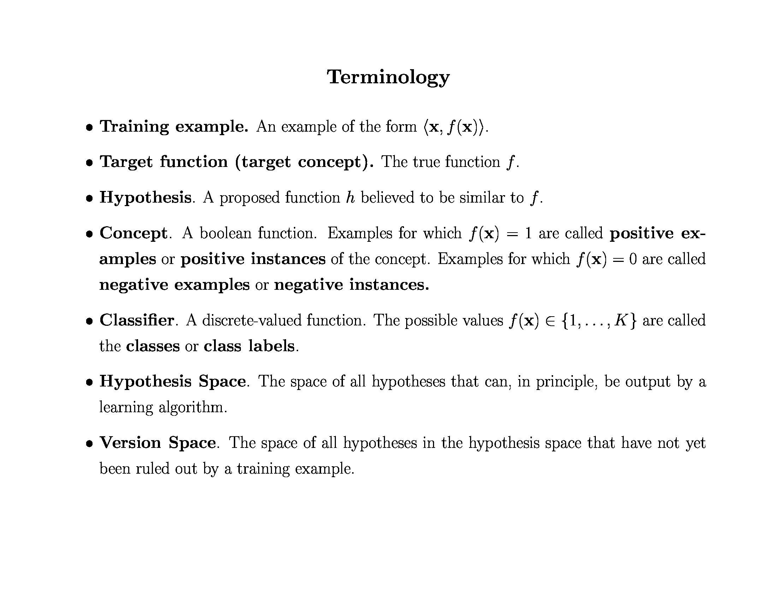
© Daniel S. Weld

Slide 17
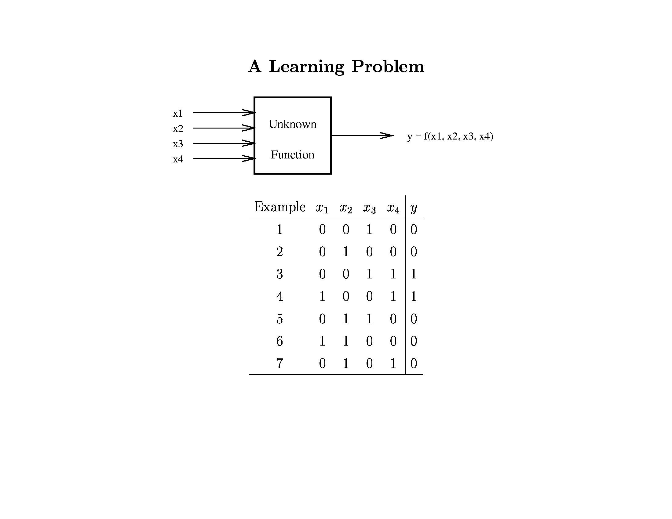
© Daniel S. Weld

Slide 18
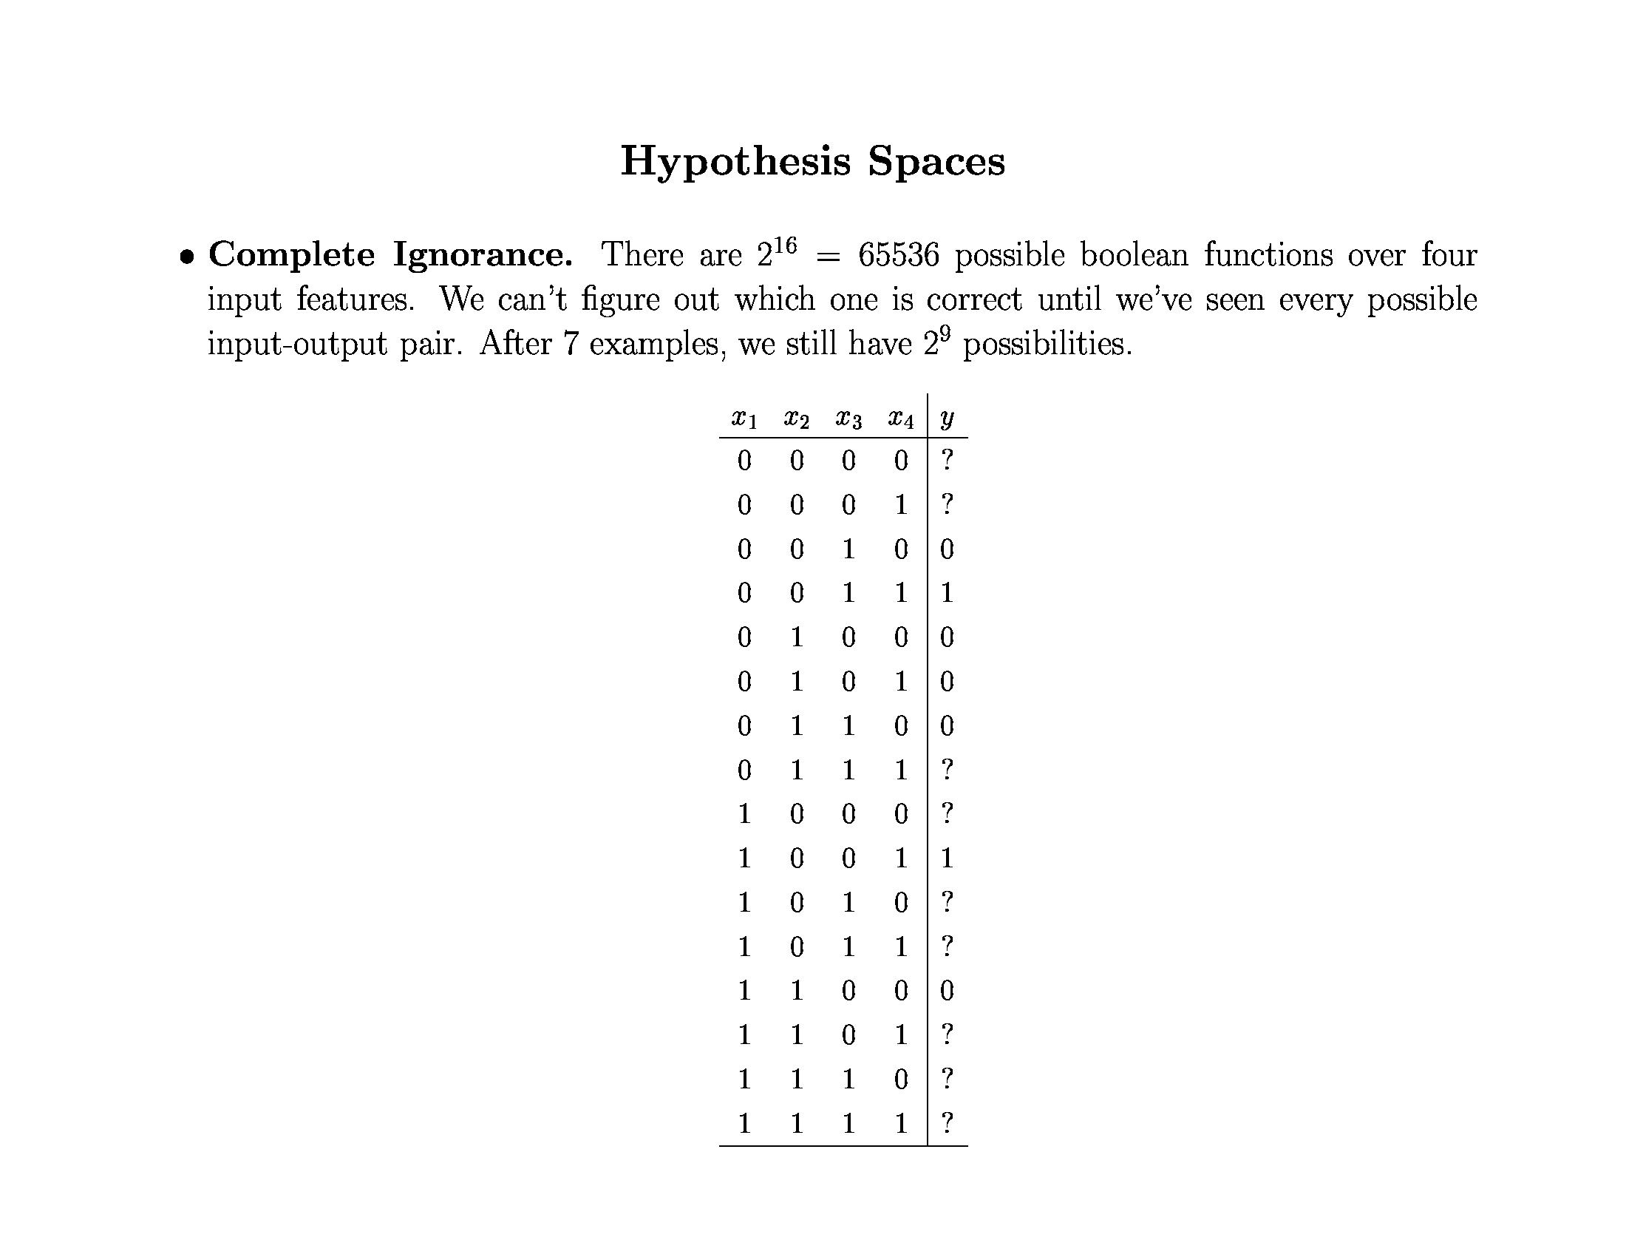
© Daniel S. Weld

Slide 19
Inductive Bias
Need to make assumptions
  Experience alone doesn’t allow us to make conclusions about unseen data instances
Two types of bias:
  Restriction: Limit the hypothesis space
  (e.g., look at rules)
  Preference: Impose ordering on hypothesis space (e.g., more general, consistent with data)

Slide 20
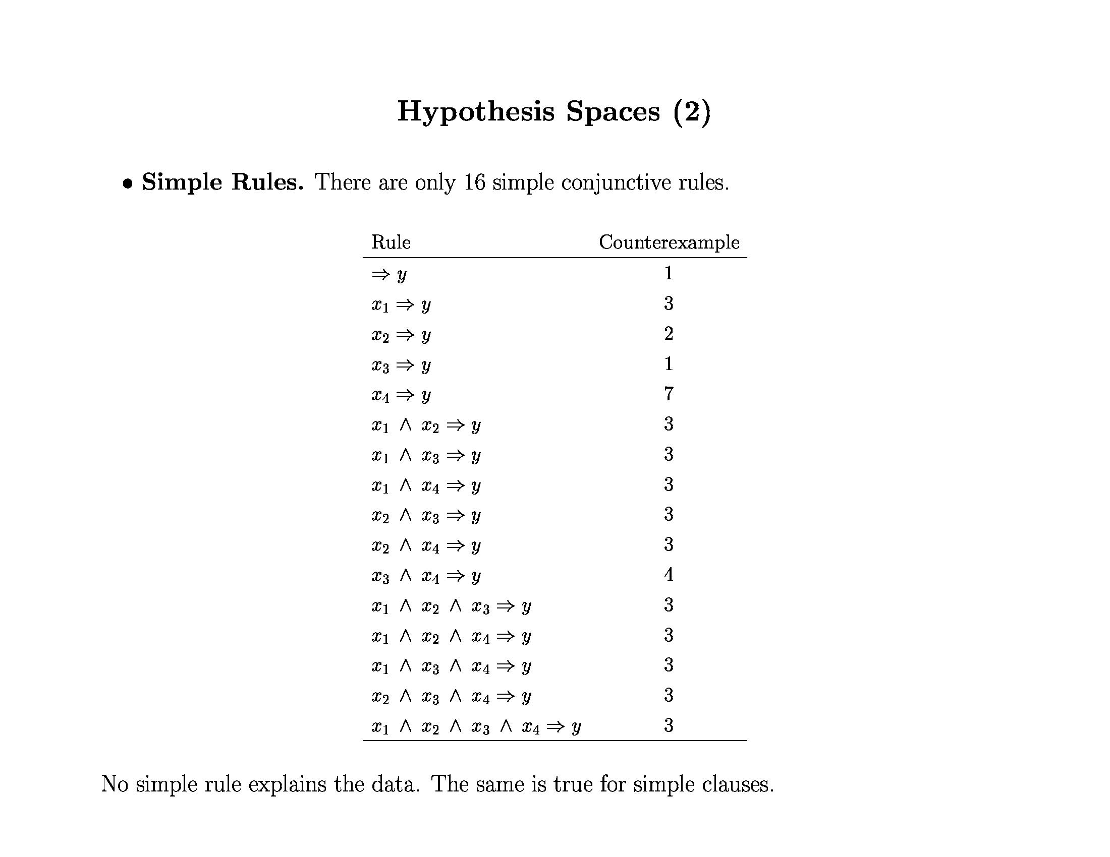
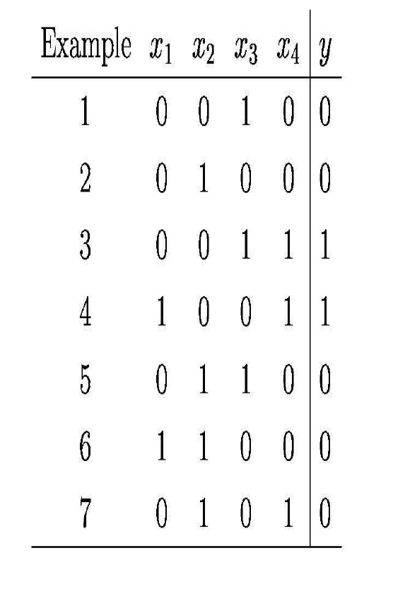
© Daniel S. Weld

Slide 21
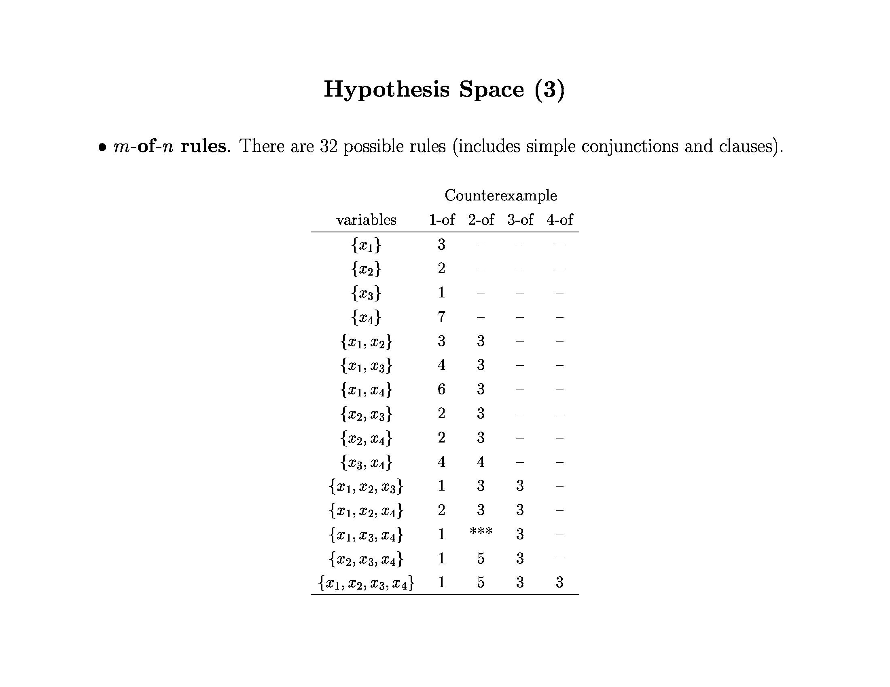
x₁ ⇒ y
x₃ ⇒ y
x₄ ⇒ y
© Daniel S. Weld

Slide 22
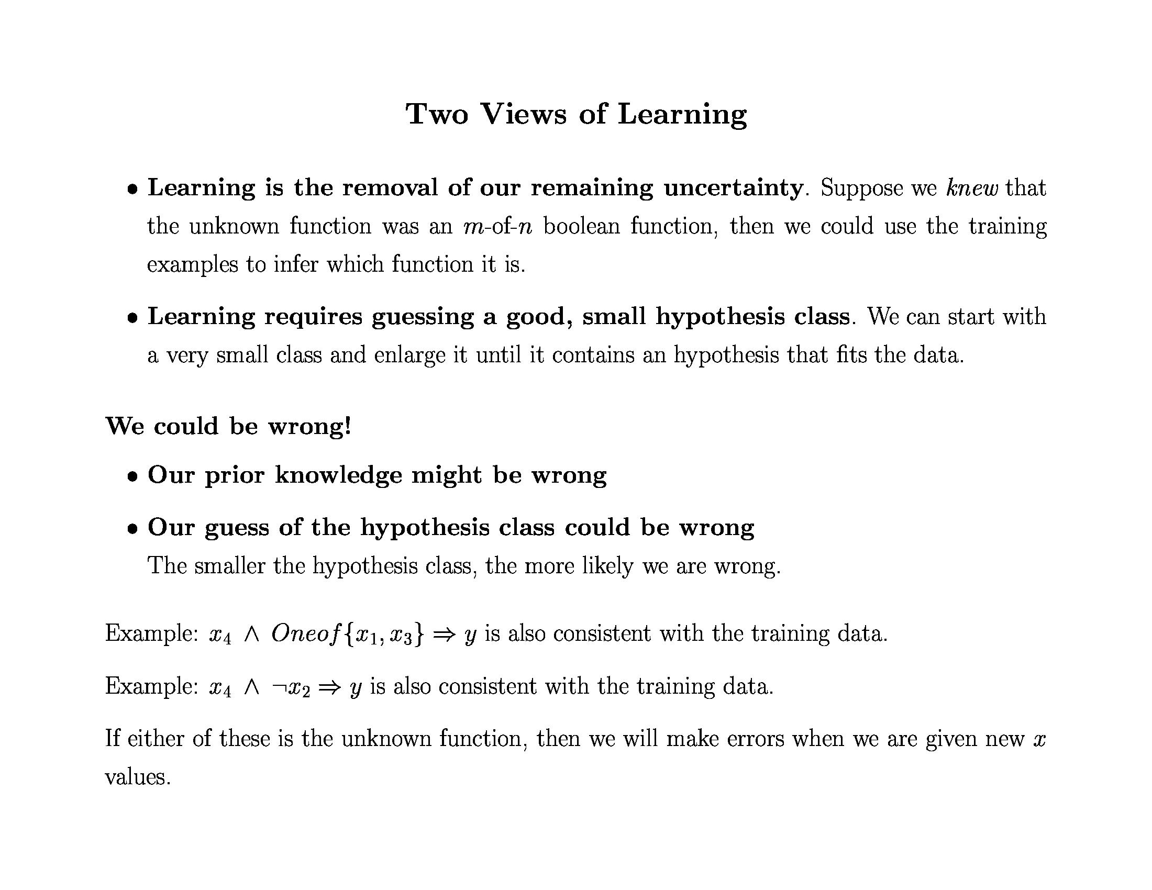
© Daniel S. Weld

Slide 23
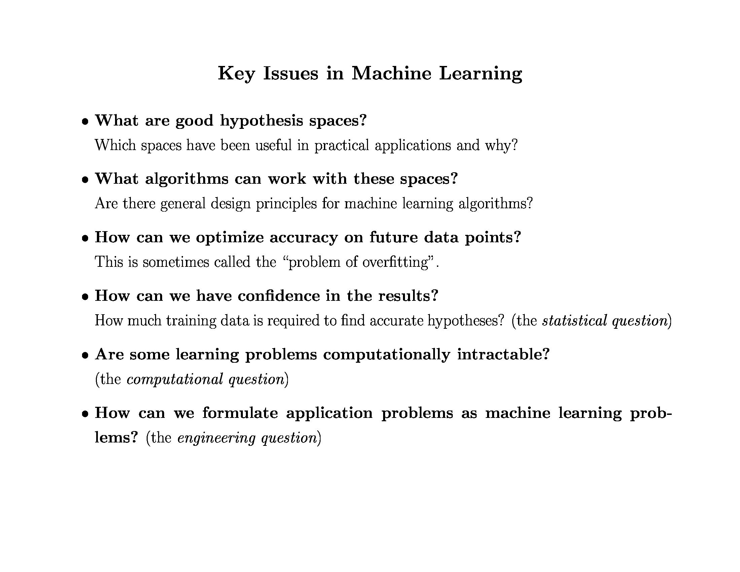
© Daniel S. Weld

Slide 24
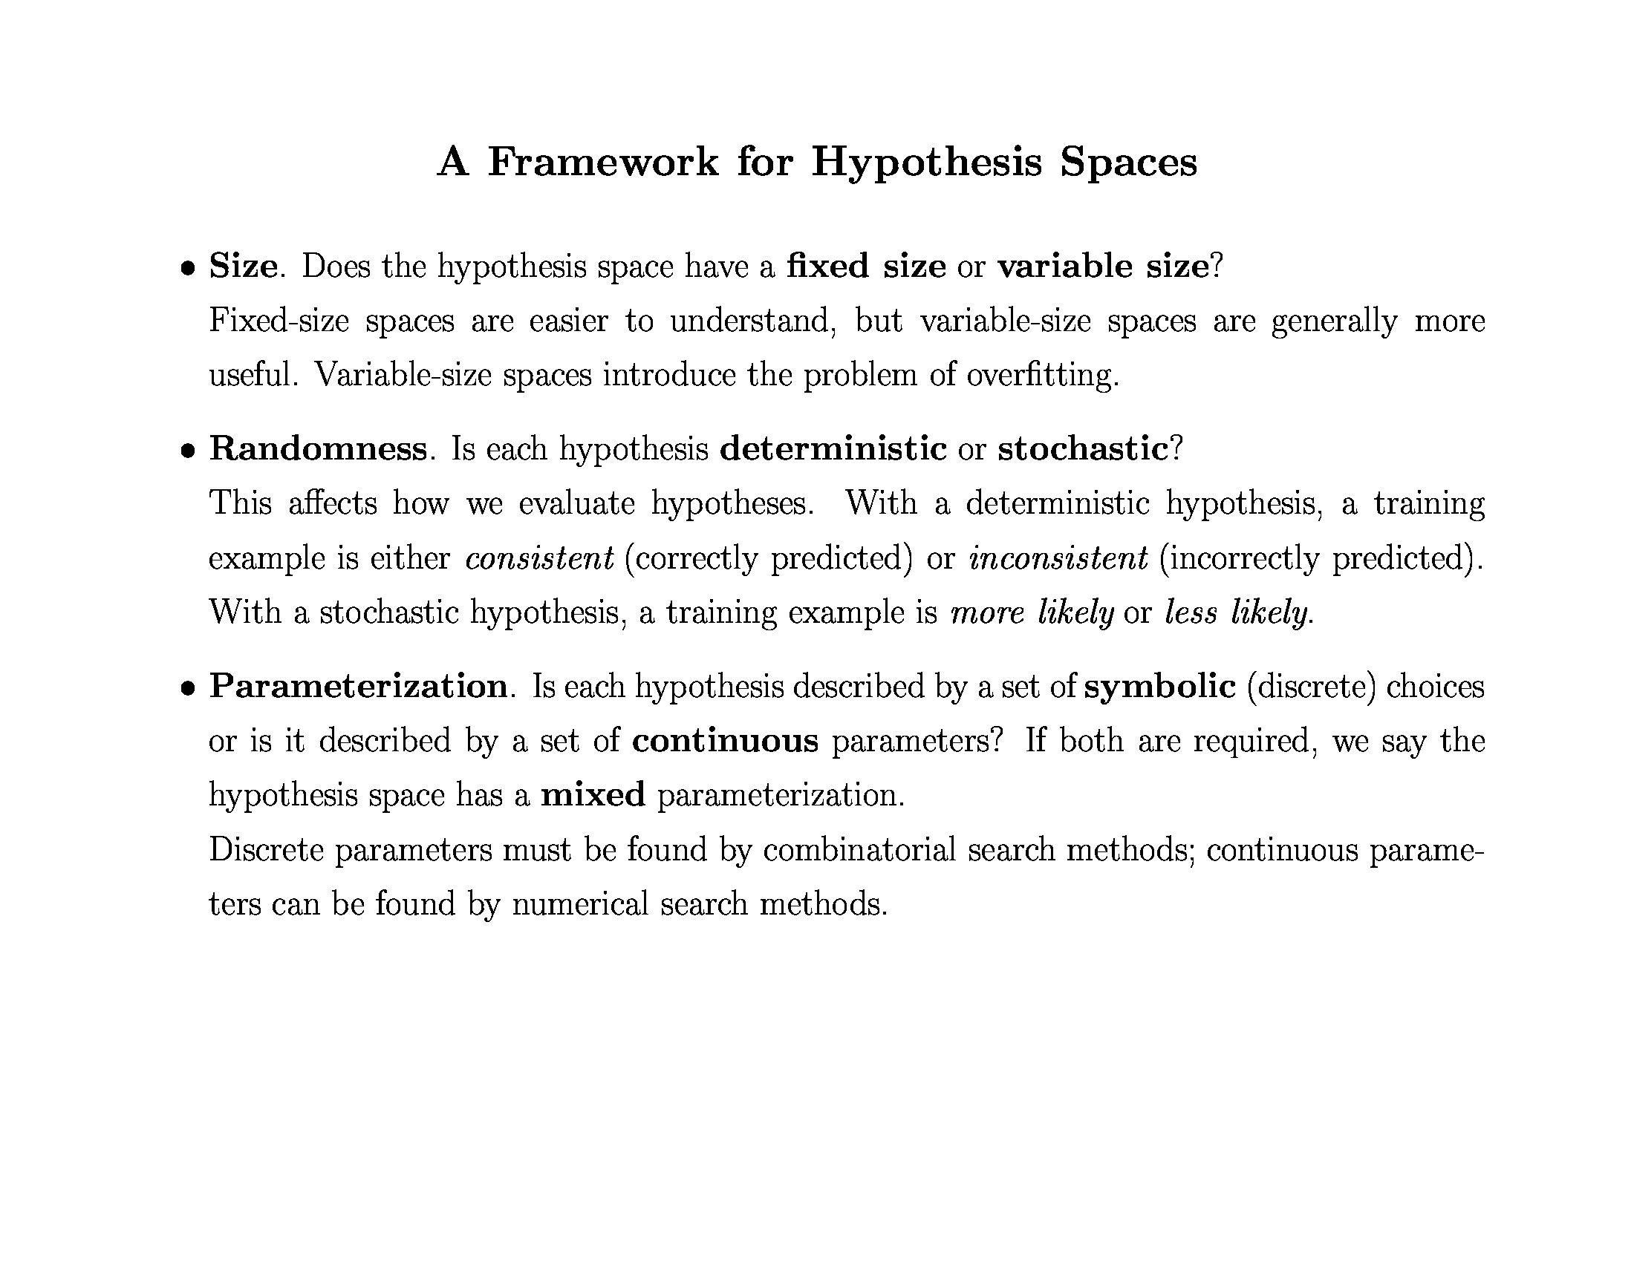
© Daniel S. Weld

Slide 25
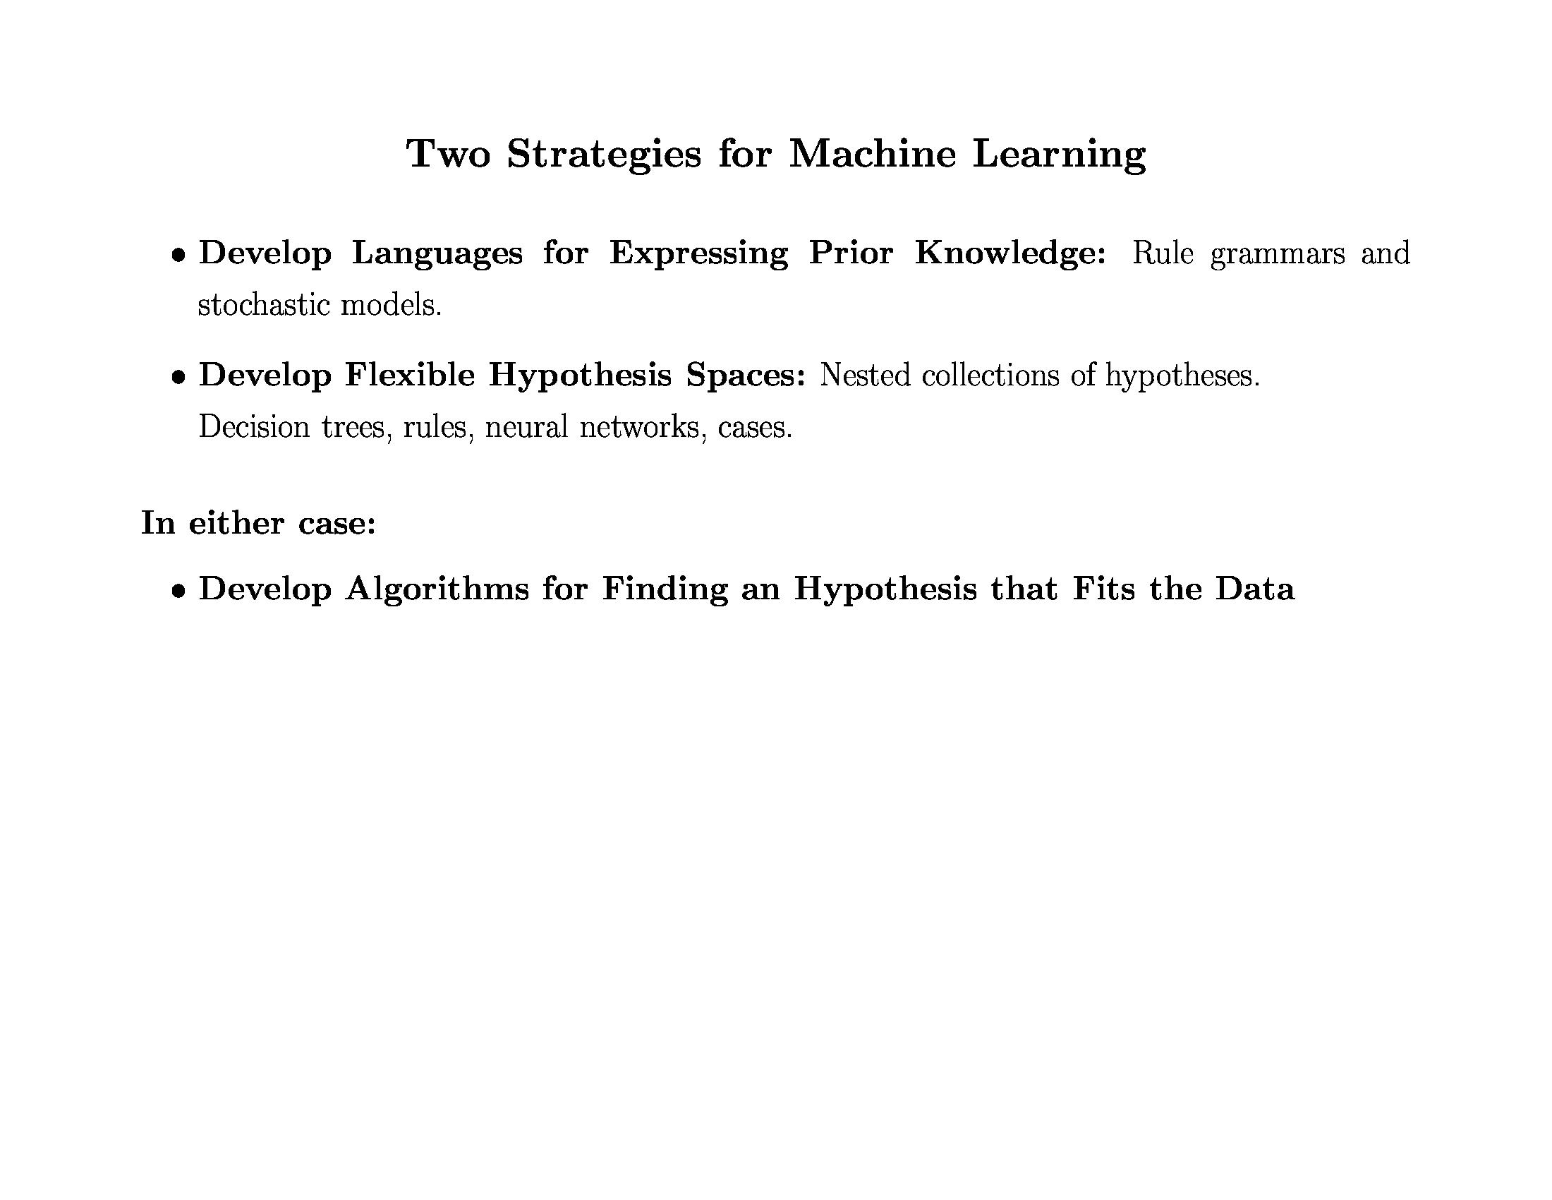
© Daniel S. Weld

Slide 26
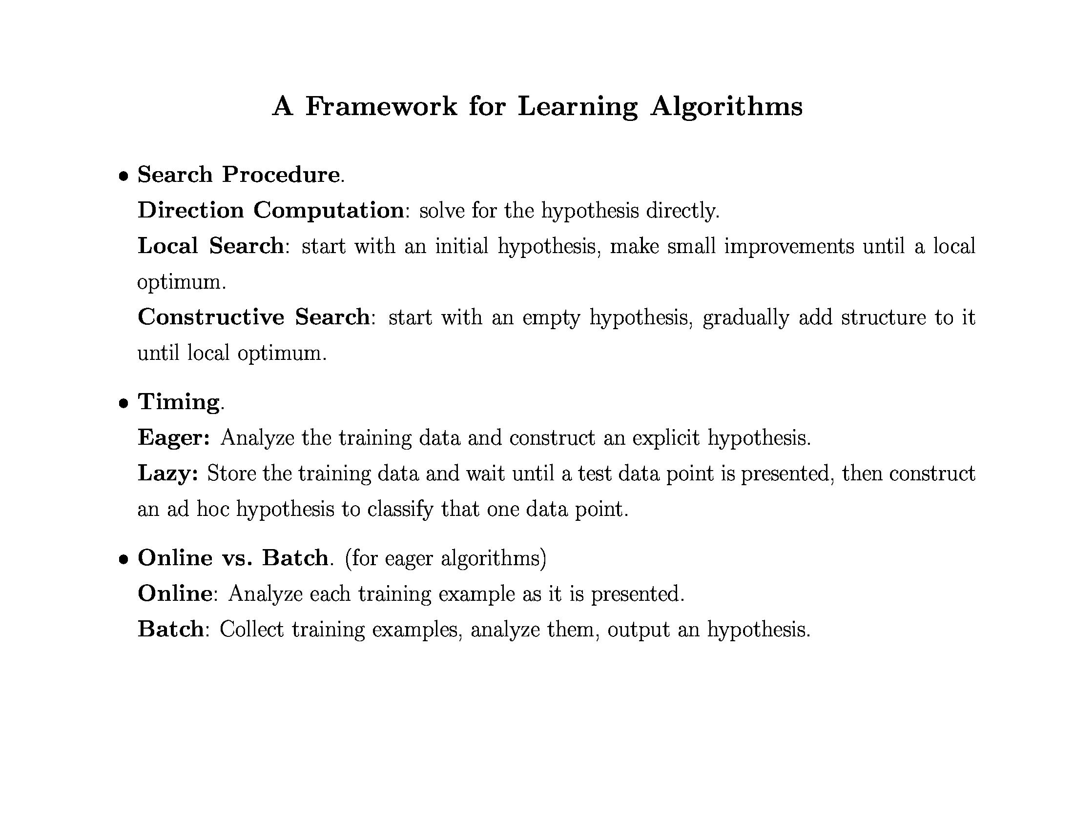
© Daniel S. Weld

Slide 27
Eager
0.0 1.0 2.0 3.0
+
+
Label: +
+
Label: -
+
-
+
+
-
-
-
-
+
+
-
-
+
-
-
+
-
-
+
+
+
-
-
0.0 1.0 2.0 3.0 4.0 5.0 6.0

Slide 28
Eager
0.0 1.0 2.0 3.0
Label: +
Label: -
?
?
?
?
0.0 1.0 2.0 3.0 4.0 5.0 6.0

Slide 29
Lazy
0.0 1.0 2.0 3.0
+
+
?
+
+
-
+
+
-
-
-
-
+
+
-
?
Label based on neighbors
?
-
+
-
-
+
-
-
+
+
+
-
?
-
0.0 1.0 2.0 3.0 4.0 5.0 6.0

Slide 30
Batch
0.0 1.0 2.0 3.0
0.0 1.0 2.0 3.0 4.0 5.0 6.0

Slide 31
Batch
0.0 1.0 2.0 3.0
+
+
Label: +
+
Label: -
+
-
+
+
-
-
-
-
+
+
-
-
+
-
-
+
-
-
+
+
+
-
-
0.0 1.0 2.0 3.0 4.0 5.0 6.0

Slide 32
Online
0.0 1.0 2.0 3.0
0.0 1.0 2.0 3.0 4.0 5.0 6.0

Slide 33
Online
0.0 1.0 2.0 3.0
+
Label: -
Label: +
-
0.0 1.0 2.0 3.0 4.0 5.0 6.0

Slide 34
Online
0.0 1.0 2.0 3.0
+
Label: -
+
Label: +
-
0.0 1.0 2.0 3.0 4.0 5.0 6.0

Slide 35
Online
0.0 1.0 2.0 3.0
+
+
Label: +
Label: -
-
0.0 1.0 2.0 3.0 4.0 5.0 6.0

Slide 36
Outline
Brief overview of learning
Inductive learning
Decision trees

Slide 37
Decision Trees
Convenient Representation
  Developed with learning in mind
  Deterministic
  Comprehensible output
Expressive
  Equivalent to propositional DNF
  Handles discrete and continuous parameters
Simple learning algorithm
  Handles noise well
  Classify as follows
    Constructive (build DT by adding nodes)
    Eager
    Batch (but incremental versions exist)

Slide 38
Concept Learning
E.g., Learn concept “Edible mushroom”
  Target Function has two values: T or F
Represent concepts as decision trees
Use hill climbing search thru
space of decision trees
  Start with simple concept
  Refine it into a complex concept as needed

Slide 39
Example: “Good day for tennis”
Attributes of instances
  Outlook = {rainy (r), overcast (o), sunny (s)}
  Temperature = {cool (c), medium (m), hot (h)}
  Humidity = {normal (n), high (h)}
  Wind = {weak (w), strong (s)}
Class value
  Play Tennis? = {don’t play (n), play (y)}
Feature = attribute with one value
  E.g., outlook = sunny
Sample instance
  outlook=sunny, temp=hot, humidity=high, wind=weak

Slide 40
Experience: “Good day for tennis”
Day Outlook Temp Humid Wind PlayTennis?
d1 s h h w n
d2 s h h s n
d3 o h h w y
d4 r m h w y
d5 r c n w y
d6 r c n s n
d7 o c n s y
d8 s m h w n
d9 s c n w y
d10 r m n w y
d11 s m n s y
d12 o m h s y
d13 o h n w y
d14 r m h s n

Slide 41
Decision Tree Representation
Good day for tennis?
Leaves = classification
Arcs = choice of value
for parent attribute
Outlook
Sunny
Rain
Overcast
Humidity
Wind
Play
Strong
Weak
High
Normal
Don’t play
Play
Don’t play
Play
Decision tree is equivalent to logic in disjunctive normal form
Play ⇔ (Sunny ∧ Normal) ∨ Overcast ∨ (Rain ∧ Weak)

Slide 42
Numeric Attributes
Use thresholds to convert numeric attributes into discrete values
Outlook
Sunny
Rain
Overcast
Humidity
Wind
Play
>= 10 MPH
< 10 MPH
>= 75%
< 75%
Don’t play
Play
Don’t play
Play

Slide 43
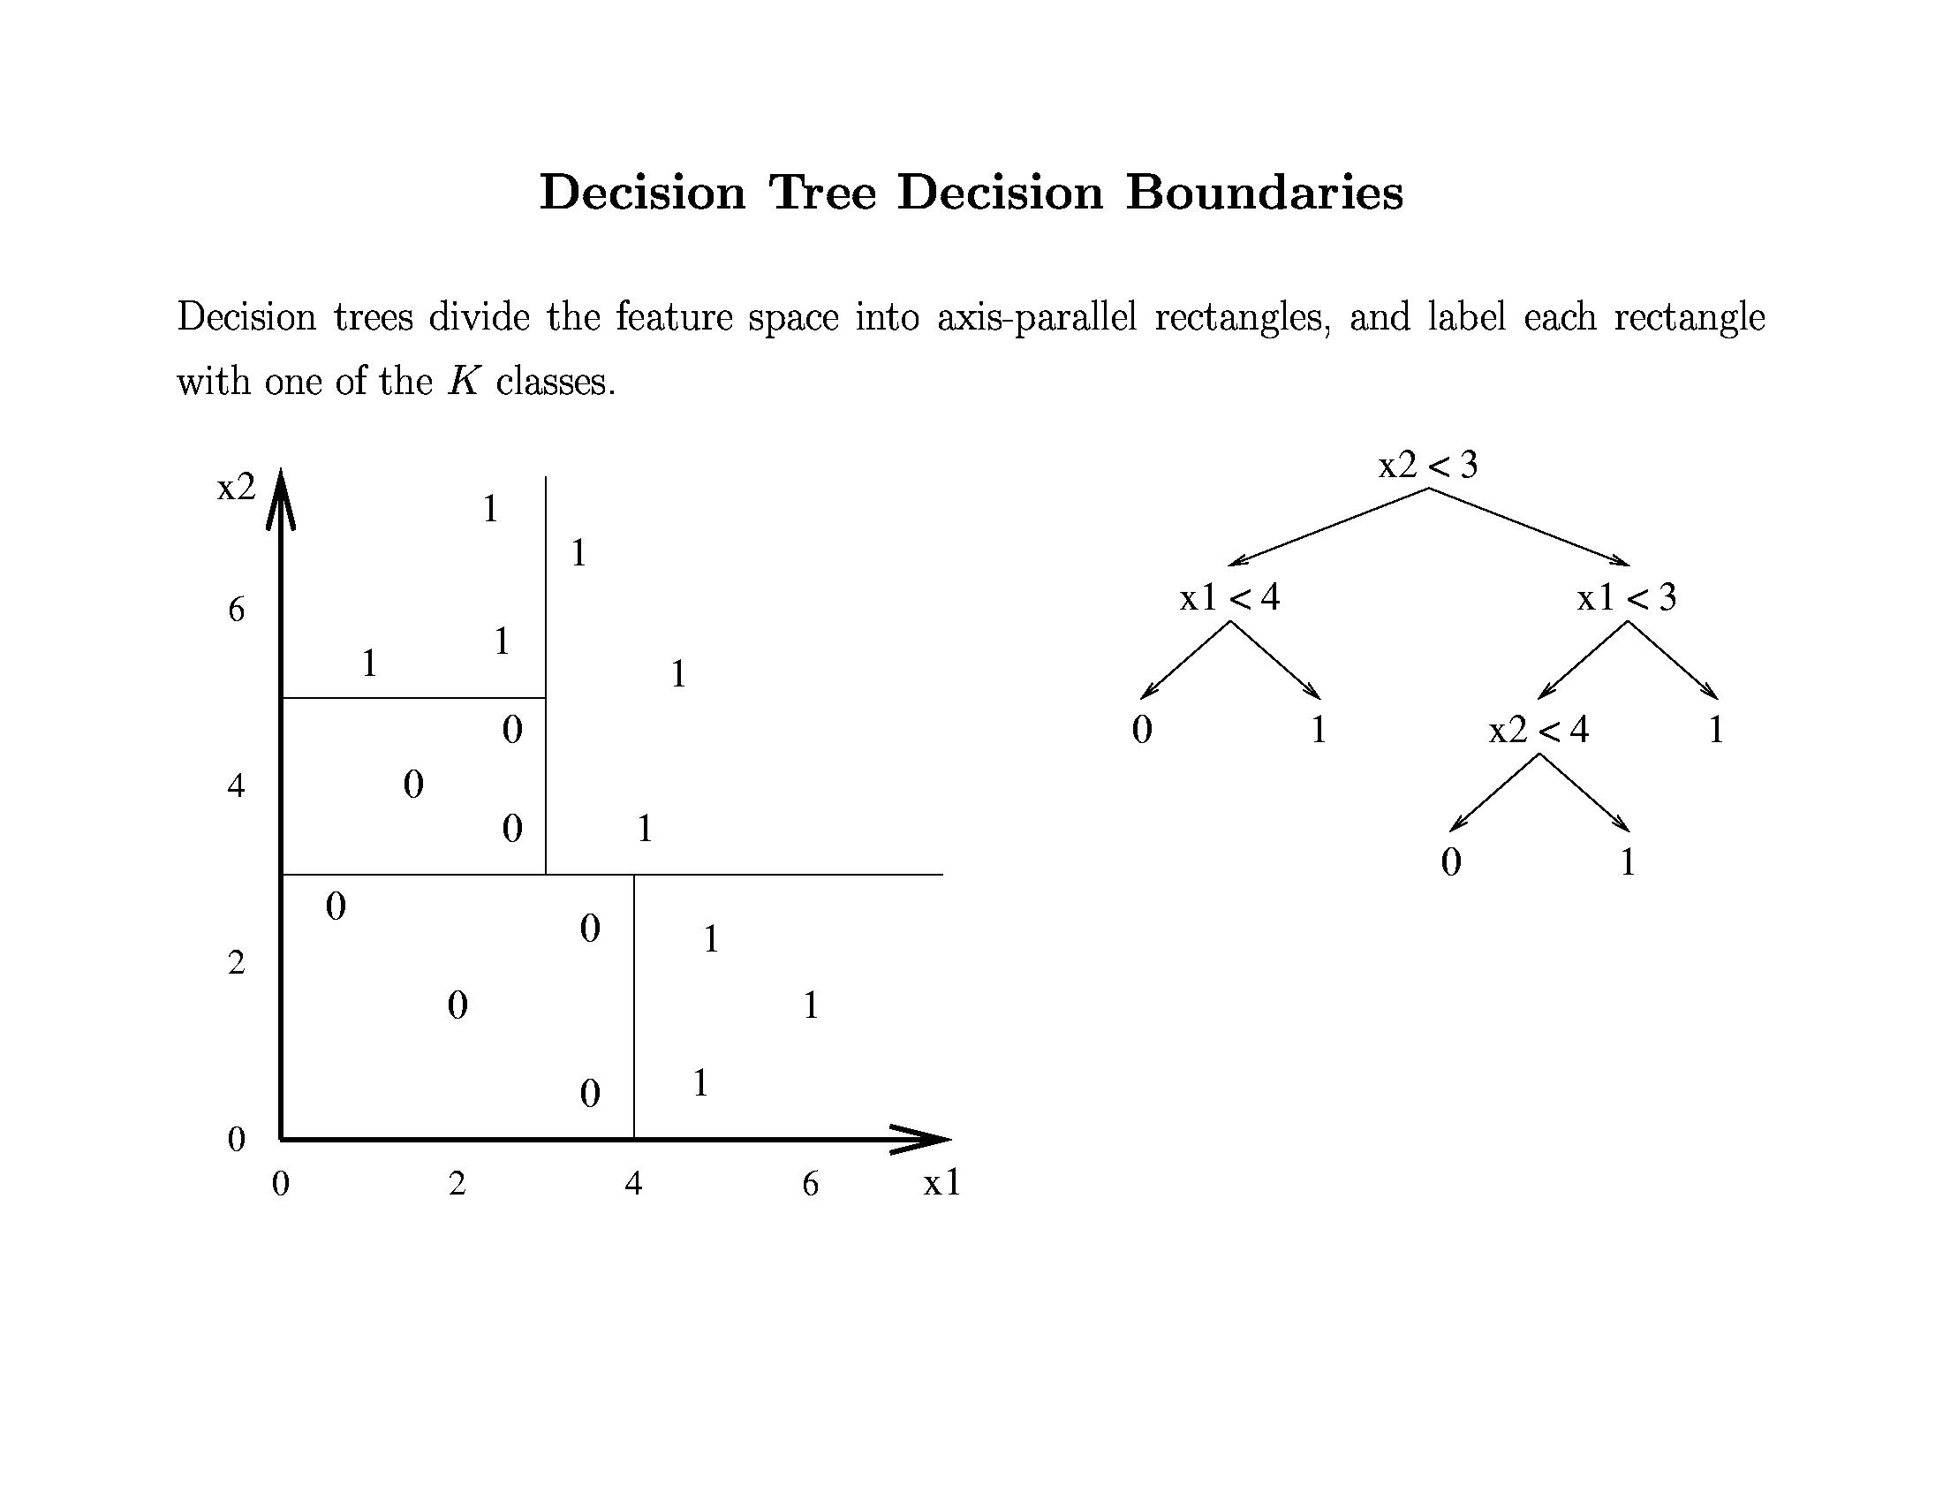
© Daniel S. Weld

Slide 44
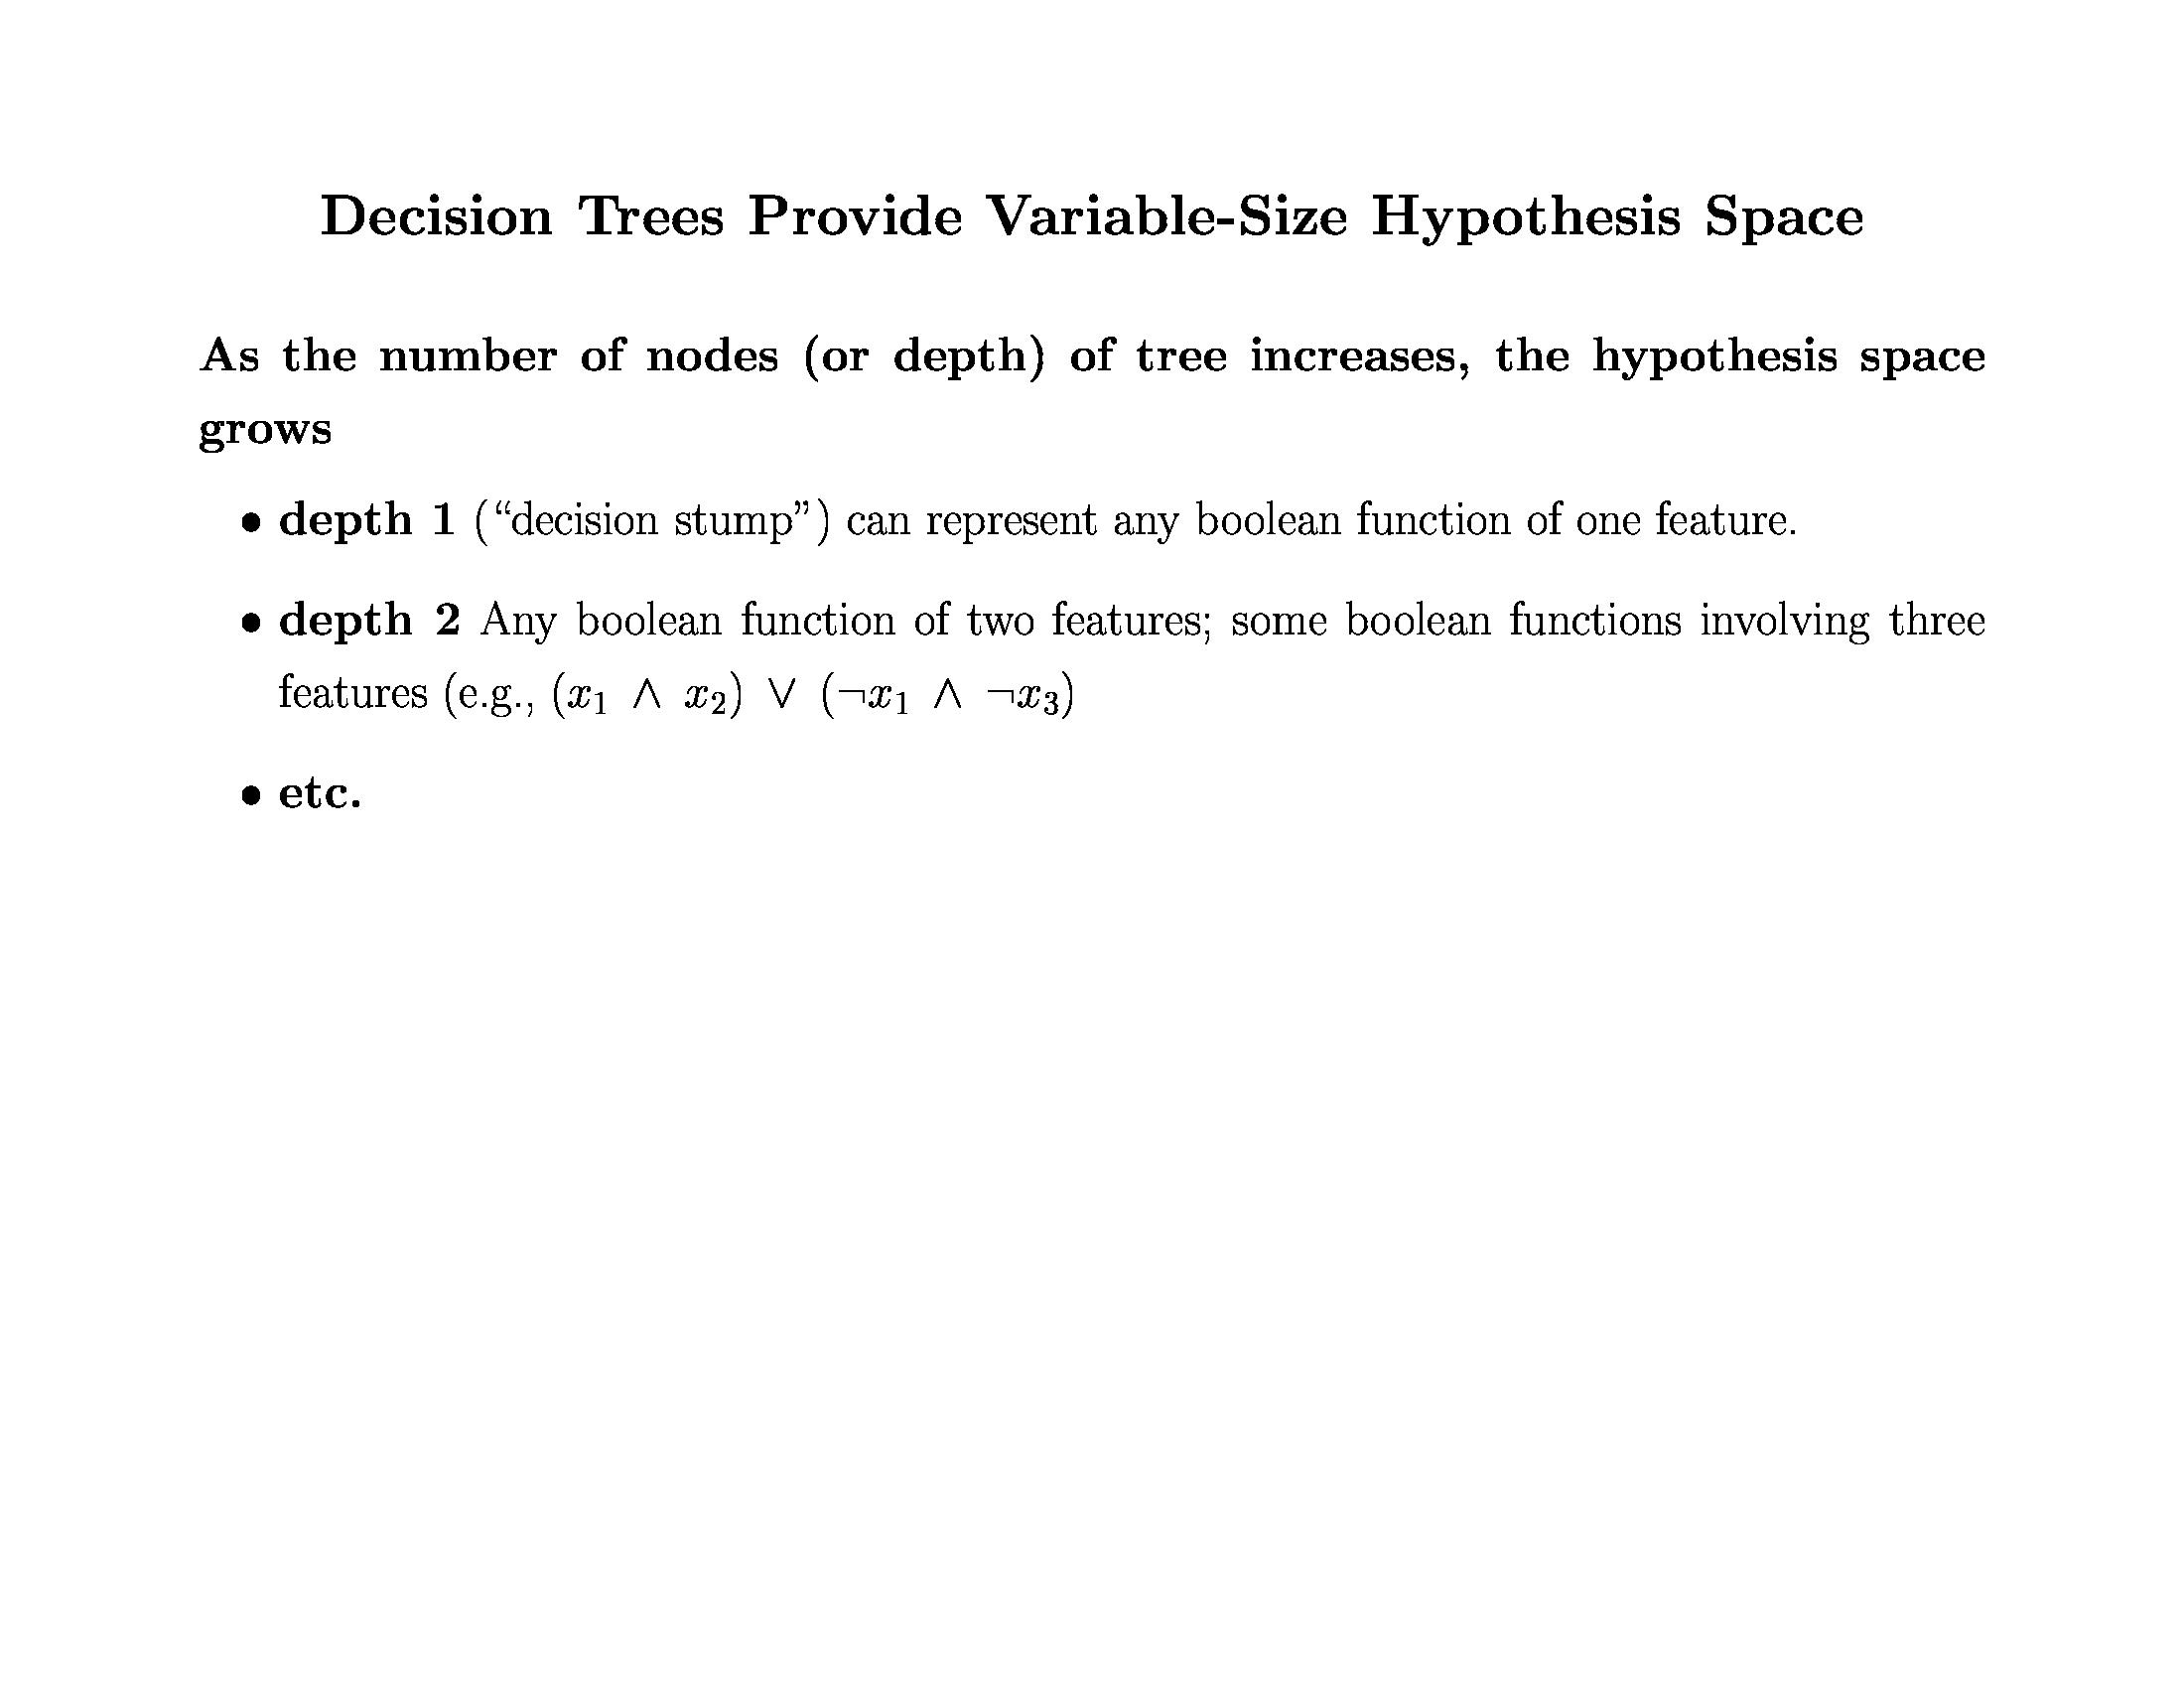
© Daniel S. Weld

Slide 45
DT Learning as Search
Nodes
Operators
Initial node
Heuristic?
Goal?
Decision Trees
Tree Refinement: Sprouting the tree
Smallest tree possible: a single leaf
Information Gain
Best tree possible (???)

Slide 46
What is the
Simplest Tree?
Day Outlook Temp Humid Wind Play?
d1 s h h w n
d2 s h h s n
d3 o h h w y
d4 r m h w y
d5 r c n w y
d6 r c n s n
d7 o c n s y
d8 s m h w n
d9 s c n w y
d10 r m n w y
d11 s m n s y
d12 o m h s y
d13 o h n w y
d14 r m h s n
How good?
Majority class:
correct on 9 examples
incorrect on 5 examples
[9+, 5-]

Slide 47
Successors
Yes
Humid
Wind
Outlook
Temp
Which attribute should we use to split?
© Daniel S. Weld

Slide 48
Disorder is bad
Homogeneity is good
No
Better
Bad
Good

Slide 49
Entropy
50-50 class split
Maximum disorder
1.0
0.5
All positive
Pure distribution
% of example that are positive
.00 .50 1.00
© Daniel S. Weld

Slide 50
Entropy (disorder) is bad
Homogeneity is good
Let S be a set of examples
Entropy(S) = -P log₂(P) - N log₂(N)
  P is proportion of pos example
  N is proportion of neg examples
  0 log 0 == 0
Example: S has 9 pos and 5 neg
Entropy([9+, 5-]) = -(9/14) log₂(9/14) - (5/14)log₂(5/14)
  = 0.940

Slide 51
Information Gain
Measure of expected reduction in entropy
Resulting from splitting along an attribute
Σ
v ∈ Values(A)
Gain(S,A) = Entropy(S) - (|Sv| / |S|) Entropy(Sv)
Where Entropy(S) = -P log₂(P) - N log₂(N)

Slide 52
Gain of Splitting on Wind
Values(wind)=weak, strong
S = [9+, 5-]
Day Wind Tennis?
d1 weak n
d2 s n
d3 weak yes
d4 weak yes
d5 weak yes
d6 s n
d7 s yes
d8 weak n
d9 weak yes
d10 weak yes
d11 s yes
d12 s yes
d13 weak yes
d14 s n
S_{weak} = [6+, 2-]
S_{s} = [3+, 3-]
Gain(S, wind)
= Entropy(S) - (|S_{v}| / |S|) Entropy(S_{v})
= Entropy(S) - 8/14 Entropy(S_{weak})
- 6/14 Entropy(S_{s})
= 0.940 - (8/14) 0.811 - (6/14) 1.00
= .048
Σ
v ∈ {weak, s}

Slide 53
Decision Tree Algorithm
BuildTree(TraingData)
Split(TrainingData)
Split(D)
If (all points in D are of the same class)
Then Return
For each attribute A
Evaluate splits on attribute A
Use best split to partition D into D1, D2
Split (D1)
Split (D2)

Slide 54
Evaluating Attributes
Yes
Humid
Wind
Gain(S,Wind)
=0.048
Gain(S,Humid)
=0.151
Outlook
Temp
Gain(S,Outlook)
=0.246
Gain(S,Temp)
=0.029

Slide 55
Resulting Tree
Good day for tennis?
Outlook
Sunny
Rain
Overcast
Don’t Play
[2+, 3-]
Don’t Play
[3+, 2-]
Play
[4+]

Slide 56
Recurse
Good day for tennis?
Outlook
Sunny
Rain
Overcast
Day Temp Humid Wind Tennis?
d1 h h weak n
d2 h h s n
d8 m h weak n
d9 c n weak yes
d11 m n s yes

Slide 57
One Step Later
Good day for tennis?
Outlook
Sunny
Rain
Overcast
Humidity
Don’t Play
[2+, 3-]
Play
[4+]
High
Normal
Don’t play
[3-]
Play
[2+]

Slide 58
Recurse Again
Good day for tennis?
Outlook
Sunny
Medium
Overcast
Humidity
Day Temp Humid Wind Tennis?
d4 m h weak yes
d5 c n weak yes
d6 c n s n
d10 m n weak yes
d14 m h s n
High
Low

Slide 59
One Step Later: Final Tree
Good day for tennis?
Outlook
Sunny
Rain
Overcast
Humidity
Wind
Play
[4+]
Strong
Weak
High
Normal
Don’t play
[2-]
Play
[3+]
Don’t play
[3-]
Play
[2+]

Slide 60
Issues
Missing data
Real-valued attributes
Many-valued features
Evaluation
Overfitting

Slide 61
Missing Data 1
Day Temp Humid Wind Tennis?
d1 h h weak n
d2 h h s n
d8 m h weak n
d9 c ? weak yes
d11 m n s yes
Assign most common value at this node
?=>h
Day Temp Humid Wind Tennis?
d1 h h weak n
d2 h h s n
d8 m h weak n
d9 c ? weak yes
d11 m n s yes
Assign most common value for class
?=>n

Slide 62
Missing Data 2
Day Temp Humid Wind Tennis?
d1 h h weak n
d2 h h s n
d8 m h weak n
d9 c ? weak yes
d11 m n s yes
[0.75+, 3-]
[1.25+, 0-]
75% h and 25% n
Use in gain calculations
Further subdivide if other missing attributes
Same approach to classify test ex with missing attr
  Classification is most probable classification
  Summing over leaves where it got divided

Slide 63
Real-valued Features
Discretize?
Threshold split using observed values?
8
n
25
n
7
y
6
y
6
y
10
n
12
y
5
n
7
y
7
y
12
y
10
y
7
y
11
n
Wind
Play
25
n
Wind
Play
12
y
12
y
11
n
10
y
10
n
8
n
7
y
7
y
7
y
7
y
6
y
6
y
5
n
>= 12
Gain = 0.0004
>= 10
Gain = 0.048

Slide 64
Many-valued Attributes
Problem:
  If attribute has many values, Gain will select it
  Imagine using Date = June_6_1996
So many values
  Divides examples into tiny sets
  Sets are likely uniform => high info gain
  Poor predictor
Penalize these attributes

Slide 65
One Solution: Gain Ratio
Gain Ratio(S,A) = Gain(S,A)/SplitInfo(S,A)
SplitInfo = (|Sv| / |S|) Log2(|Sv|/|S|)
Σ
v ∈ Values(A)
SplitInfo ≅ entropy of S wrt values of A
  (Contrast with entropy of S wrt target value)
attribs with many uniformly distrib values
  e.g. if A splits S uniformly into n sets
  SplitInformation = log₂(n)… = 1 for Boolean

Slide 66
Evaluation: Cross Validation
Partition examples into k disjoint sets
Now create k training sets
  Each set is union of all equiv classes except one
  So each set has (k-1)/k of the original training data
← Train →
Test
Test
Test

Slide 67
Cross-Validation (2)
Leave-one-out
  Use if < 100 examples (rough estimate)
  Hold out one example, train on remaining examples
M of N fold
  Repeat M times
  Divide data into N folds, do N fold cross-validation

Slide 68
Methodology Citations
Dietterich, T. G., (1998). Approximate Statistical Tests for Comparing Supervised Classification Learning Algorithms. Neural Computation, 10 (7) 1895-1924
Densar, J., (2006). Demsar, Statistical Comparisons of Classifiers over Multiple Data Sets. The Journal of Machine Learning Research, pages 1-30.

Slide 69
Overfitting
On training data
On test data
Accuracy
0.9
0.8
0.7
0.6
Number of Nodes in Decision tree
© Daniel S. Weld

Slide 70
Overfitting Definition
DT is overfit when exists another DT’ and
  DT has smaller error on training examples, but
  DT has bigger error on test examples
Causes of overfitting
  Noisy data, or
  Training set is too small
Solutions
  Reduced error pruning
  Early stopping
  Rule post pruning

Slide 71
Reduced Error Pruning
Split data into train and validation set
Repeat until pruning is harmful
  Remove each subtree and replace it with majority class and evaluate on validation set
  Remove subtree that leads to largest gain in accuracy
Test
Tune
Tune
Tune

Slide 72
Reduced Error Pruning Example
Outlook
Sunny
Rain
Overcast
Humidity
Wind
Play
Strong
Weak
High
Low
Don’t play
Play
Don’t play
Play
Validation set accuracy = 0.75

Slide 73
Reduced Error Pruning Example
Outlook
Sunny
Rain
Overcast
Don’t play
Wind
Play
Strong
Weak
Don’t play
Play
Validation set accuracy = 0.80

Slide 74
Reduced Error Pruning Example
Outlook
Sunny
Rain
Overcast
Humidity
Play
Play
High
Low
Don’t play
Play
Validation set accuracy = 0.70

Slide 75
Reduced Error Pruning Example
Outlook
Sunny
Rain
Overcast
Don’t play
Wind
Play
Strong
Weak
Don’t play
Play
Use this as final tree

Slide 76
Early Stopping
On training data
On test data
On validation data
Accuracy
Remember this tree and use it as the final classifier
0.9
0.8
0.7
0.6
Number of Nodes in Decision tree
© Daniel S. Weld

Slide 77
Post Rule Pruning
Split data into train and validation set
Prune each rule independently
  Remove each pre-condition and evaluate accuracy
  Pick pre-condition that leads to largest improvement in accuracy
Note: ways to do this using training data and statistical tests

Slide 78
Conversion to Rule
Outlook
Sunny
Rain
Overcast
Humidity
Wind
Play
Strong
Weak
High
Low
Don’t play
Play
Don’t play
Play
Outlook = Sunny ∧ Humidity = High ⇒ Don’t play
Outlook = Sunny ∧ Humidity = Low ⇒ Play
Outlook = Overcast ⇒ Play
…

Slide 79
Example
Outlook = Sunny ∧ Humidity = High ⇒ Don’t play
Validation set accuracy = 0.68
Outlook = Sunny ⇒ Don’t play
Validation set accuracy = 0.65
Humidity = High ⇒ Don’t play
Validation set accuracy = 0.75
Keep this rule

Slide 80
Summary
Overview of inductive learning
  Hypothesis spaces
  Inductive bias
  Components of a learning algorithm
Decision trees
  Algorithm for constructing trees
  Issues (e.g., real-valued data, overfitting)

Slide 81

end

Slide 82
Gain of Split on Humidity
Day Outlook Temp Humid Wind Play?
d1 s h h w n
d2 s h h s n
d3 o h h w y
d4 r m h w y
d5 r c n w y
d6 r c n s n
d7 o c n s y
d8 s m h w n
d9 s c n w y
d10 r m n w y
d11 s m n s y
d12 o m h s y
d13 o h n w y
d14 r m h s n
Entropy([9+,5-]) = 0.940
Entropy([4+,3-]) = 0.985
Entropy([6+,-1]) = 0.592
Gain = 0.940- 0.985/2 - 0.592/2= 0.151

Slide 83
Gain of Split on Humidity
Day Outlook Temp Humid Wind Play?
d1 s h h w n
d2 s h h s n
d3 o h h w y
d4 r m h w y
d5 r c n w y
d6 r c n s n
d7 o c n s y
d8 s m h w n
d9 s c n w y
d10 r m n w y
d11 s m n s y
d12 o m h s y
d13 o h n w y
d14 r m h s n
Gain(S,A) = Entropy(S) - (|Sv| / |S|) Entropy(Sv)
Where Entropy(S) = -P log₂(P) - N log₂(N)
Σ
v ∈ Values(A)

Slide 84
Is…
Entropy([4+,3-]) = .985
Entropy([6+,-1]) = .592
Gain = 0.940- .985/2 - .592/2= 0.151
© Daniel S. Weld

Slide 85
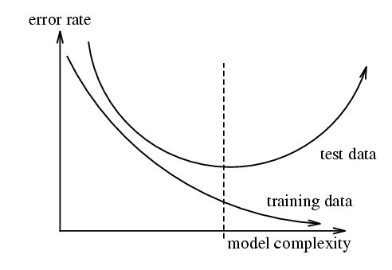
Overfitting 2
Figure from w.w.cohen
© Daniel S. Weld

Slide 86
Choosing the Training Experience
Credit assignment problem:
  Direct training examples:
    E.g. individual checker boards + correct move for each
    Supervised learning
  Indirect training examples :
    E.g. complete sequence of moves and final result
    Reinforcement learning
Which examples:
  Random, teacher chooses, learner chooses
© Daniel S. Weld

Slide 87
Example: Checkers
Task T:
  Playing checkers
Performance Measure P:
  Percent of games won against opponents
Experience E:
  Playing practice games against itself
Target Function
  V: board -> R
Representation of approx. of target function
V(b) = a + bx1 + cx2 + dx3 + ex4 + fx5 + gx6
© Daniel S. Weld

Slide 88
Choosing the Target Function
What type of knowledge will be learned?
How will the knowledge be used by the performance program?
E.g. checkers program
  Assume it knows legal moves
  Needs to choose best move
  So learn function: F: Boards -> Moves
    hard to learn
  Alternative: F: Boards -> R
Note similarity to choice of problem space
© Daniel S. Weld

Slide 89
The Ideal Evaluation Function
V(b) = 100 if b is a final, won board
V(b) = -100 if b is a final, lost board
V(b) = 0 if b is a final, drawn board
Otherwise, if b is not final
  V(b) = V(s) where s is best, reachable final board
Nonoperational…
Want operational approximation of V: V
© Daniel S. Weld

Slide 90
How Represent Target Function
x₁ = number of black pieces on the board
x₂ = number of red pieces on the board
x₃ = number of black kings on the board
x₄ = number of red kings on the board
x₅ = num of black pieces threatened by red
x₆ = num of red pieces threatened by black
V(b) = a + bx₁ + cx₂ + dx₃ + ex₄ + fx₅ + gx₆
Now just need to learn 7 numbers!
© Daniel S. Weld

Slide 91
Target Function
Profound Formulation:
  Can express any type of inductive learning as approximating a function
E.g., Checkers
  V: boards -> evaluation
E.g., Handwriting recognition
  V: image -> word
E.g., Mushrooms
  V: mushroom-attributes -> {E, P}
© Daniel S. Weld

Slide 92
Choosing the Training Experience
Credit assignment problem:
  Direct training examples:
    E.g. individual checker boards + correct move for each
    Supervised learning
  Indirect training examples :
    E.g. complete sequence of moves and final result
    Reinforcement learning
Which examples:
  Random, teacher chooses, learner chooses
© Daniel S. Weld

Slide 93
A Framework for Learning Algorithms
Search procedure
  Direction computation: Solve for hypothesis directly
  Local search: Start with an initial hypothesis on make local refinements
  Constructive search: start with empty hypothesis and add constraints
Timing
  Eager: Analyze data and construct explicit hypothesis
  Lazy: Store data and construct ad-hoc hypothesis to classify data
Online vs. batch
  Online
  Batch

